Slide 1
François Viete
John Napier - Henry Briggs
Late 1500s / 1550-1617 / 1561-1631
Journey Through Genius Pp 156
Notes:
The sixteenth and seventeenth century both saw a vast amount of mathematical discoveries and activity, the seventeenth, even overshadowing the sixteenth
The shift from the past where we saw mostly Greek, some Arabian, and then Italian mathematicians, now we will notice a European trend
The French, German and British now enter
Some scholars attribute this to the new freedom of inquiry happening in Northern Europe contrasted with the restrictions of the church in Italy
For example: Galileo’s imprisonment and disavowal due to his investigating topics that were not accepted by the church would have been enough to silence the community of scholars
The French Mathematician, Francois Viete published the influential, In Artem Analyticam Isagoge, meaning The Analytic Art
Viete was known not only for approximating pi **insert his approximation from chapter 4**
In Artem set the scene for symbolic algebra, although his symbolic algebra still differs greatly from modern day, it was a huge leap nonetheless
“D in R - D in E aequabitar A quad” would mean DR - DE = A^2, he was the first to use letters to denote quantities in an equation
He also was one of the first to work on the binomial powers which later helped Newton with discovering the binomial theorem
Two mathematicians from the British Isles, John Napier and Henry Briggs perfected the logarithm
Pierre Simon Laplace later, while studying the works of Napier and Briggs noted, “by shortening the labors doubled the life of the astronomer”

Slide 2
The beginning of the 17th century
The sixteenth and seventeenth century both saw a vast amount of mathematical discoveries and activity, the seventeenth, even overshadowing the sixteenth The shift from the past where we saw mostly Greek, some Arabian, and then Italian mathematicians, now we will notice a European trend The French, German and British now enter Some scholars attribute this to the new freedom of inquiry happening in Northern Europe contrasted with the restrictions of the church in Italy For example: Galileo’s imprisonment and disavowal due to his investigating topics that were not accepted by the church would have been enough to silence the community of scholars

Slide 3
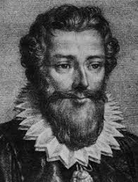
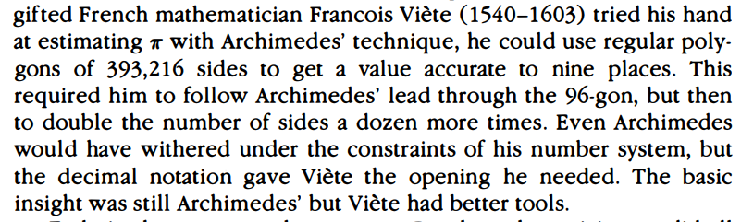
Viéte
Published In Artem Analyticam Isagoge, meaning The Analytic Art
Known for approximating 𝜋
In Atrem sets the scene for symbolic algebra, although his symbolic algebra still differs greatly from modern
First to use letters to denote unknown quantities
First to work on binomial powers, which later Newton expanded on

Slide 4
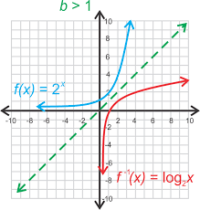
John Napier & Henry Briggs
Two mathematicians from the British Isles
Perfected the logarithm
Pierre Simon Laplace later writes while studying the works of Napier and Briggs, “by shortening the labors doubled the life of the astronomer”

